Slide 1
Level 6 Group 4

Slide 2
The brief
Game of Emergence
Multiple solutions
Single Player
PC

Slide 3
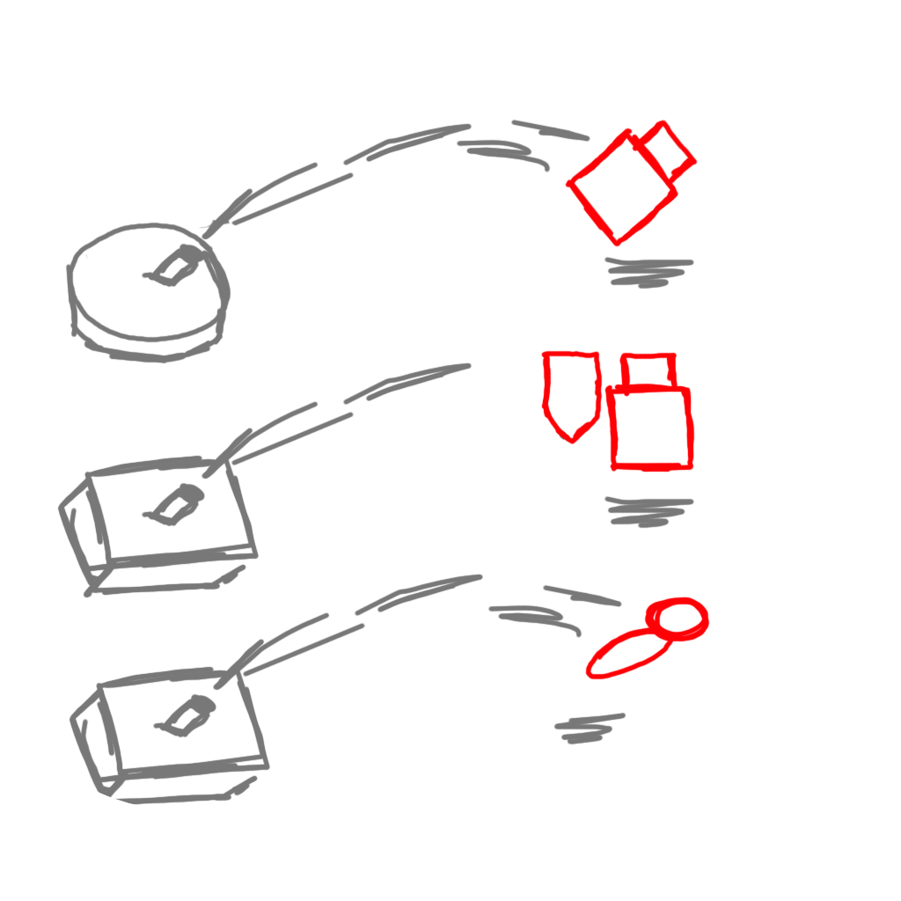
Idea One – FORTS!
Build a fort
Craft defences
Defend from attacking hordes
Males
Aged 13 to 17

Slide 4
Idea One – FORTS!
Increasing Defences vs Harder Enemies
Combinable Components
Optimal Fort Layout

Slide 5
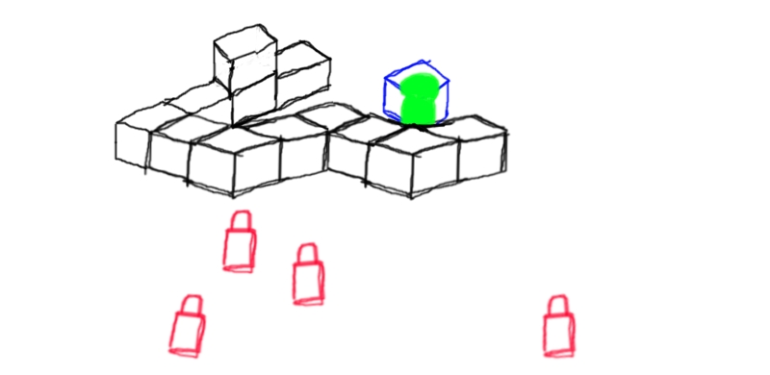
Idea One – FORTS!

Slide 6
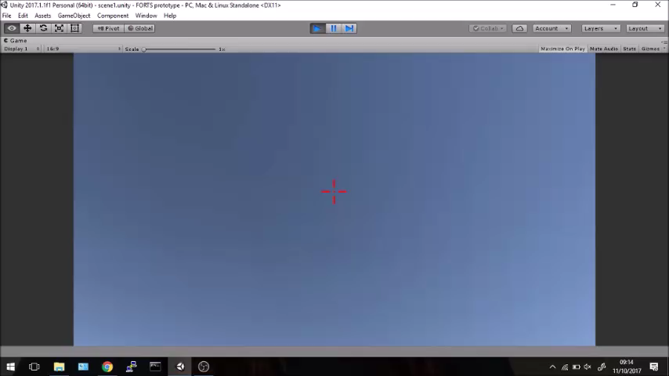
Idea One – FORTS!

Slide 7
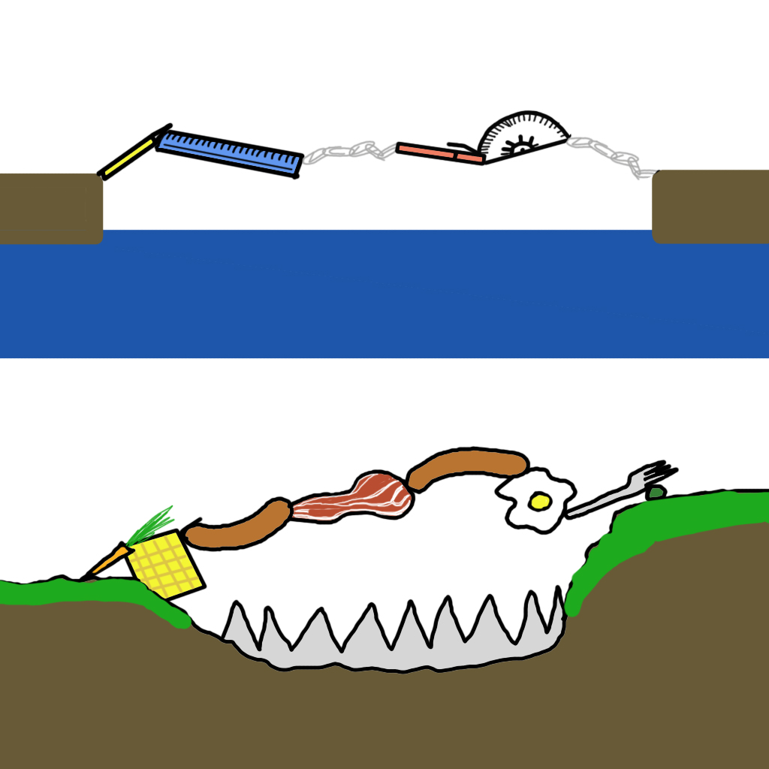
Idea two – Glue gun
Attach and Detach Objects
Get to the exit
Males
Age 10+

Slide 8
Idea two – Glue gun
Challenges in both Vertical and Horizontal
Different shapes and props

Slide 9
Idea two – Glue gun

Slide 10
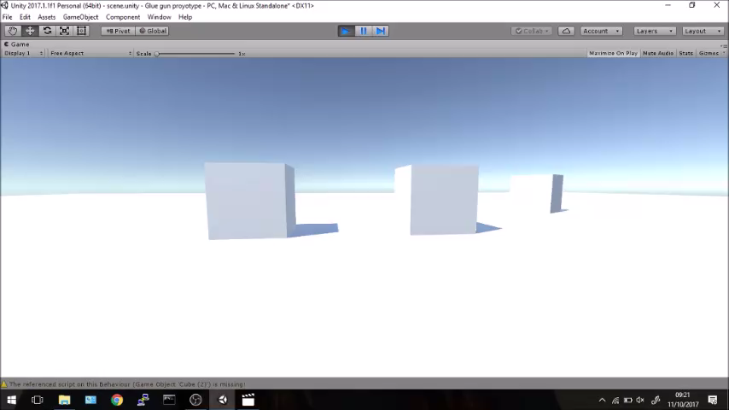
Idea two – Glue gun

Slide 11
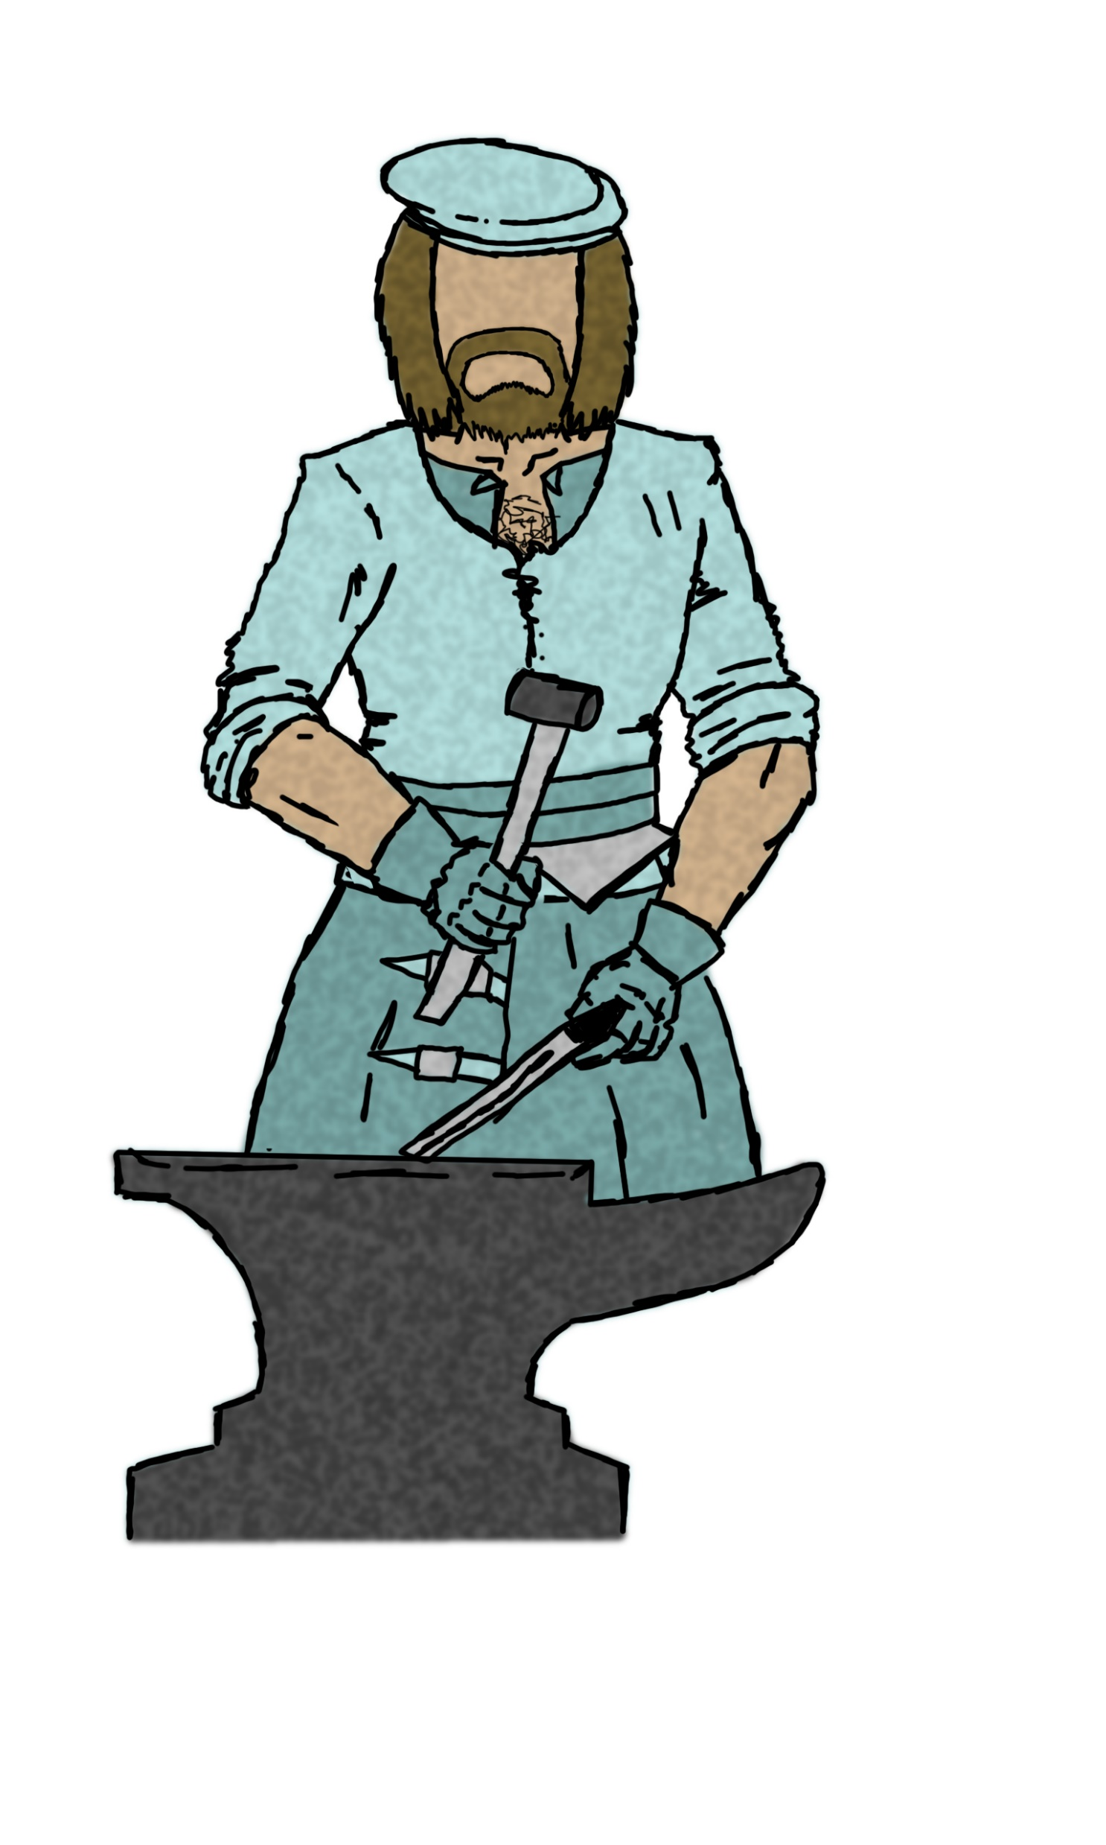
Idea Three – Monster Miner
Hunt Monsters
Gather Resources
Grow Town
Males
Aged 15-25

Slide 12
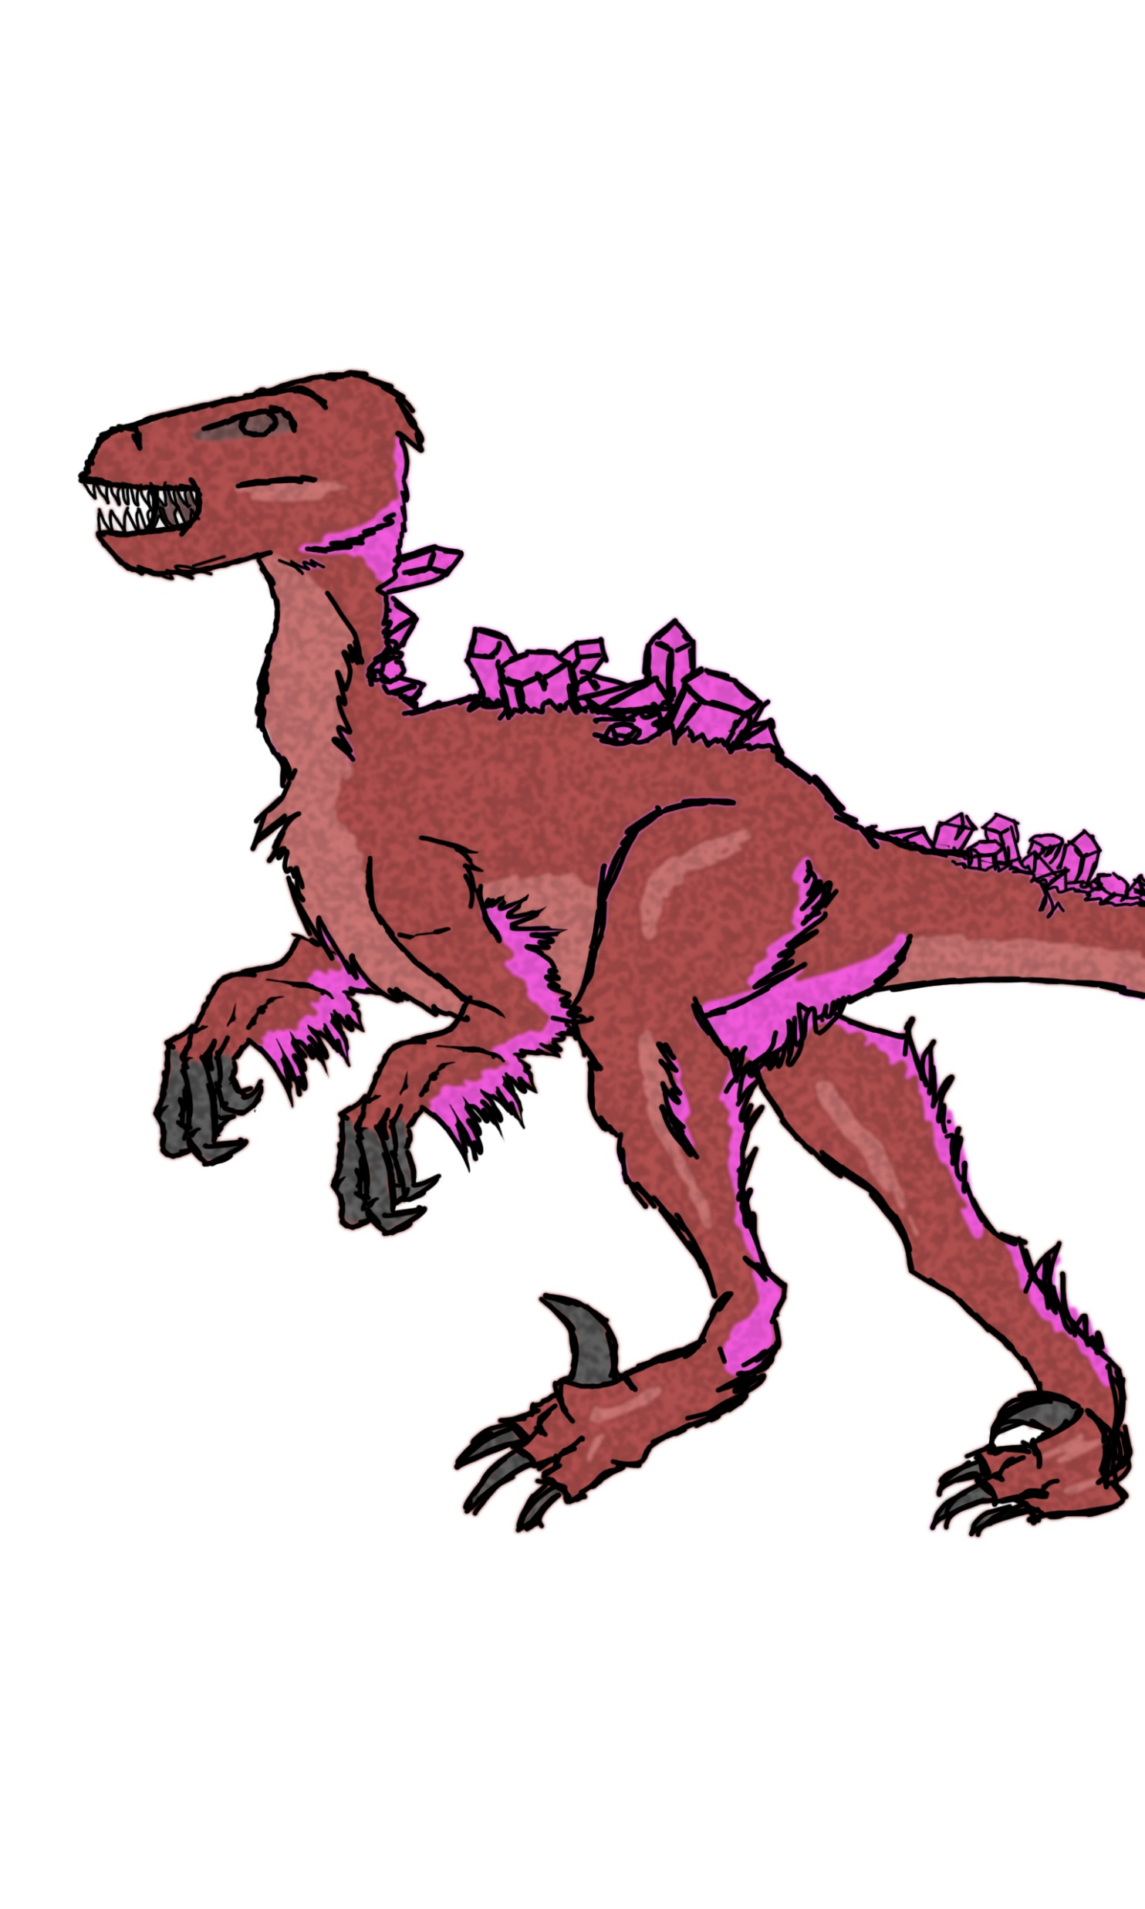
Idea Three – Monster Miner
Managing Wildlife and Resources
Survive the environment

Slide 13
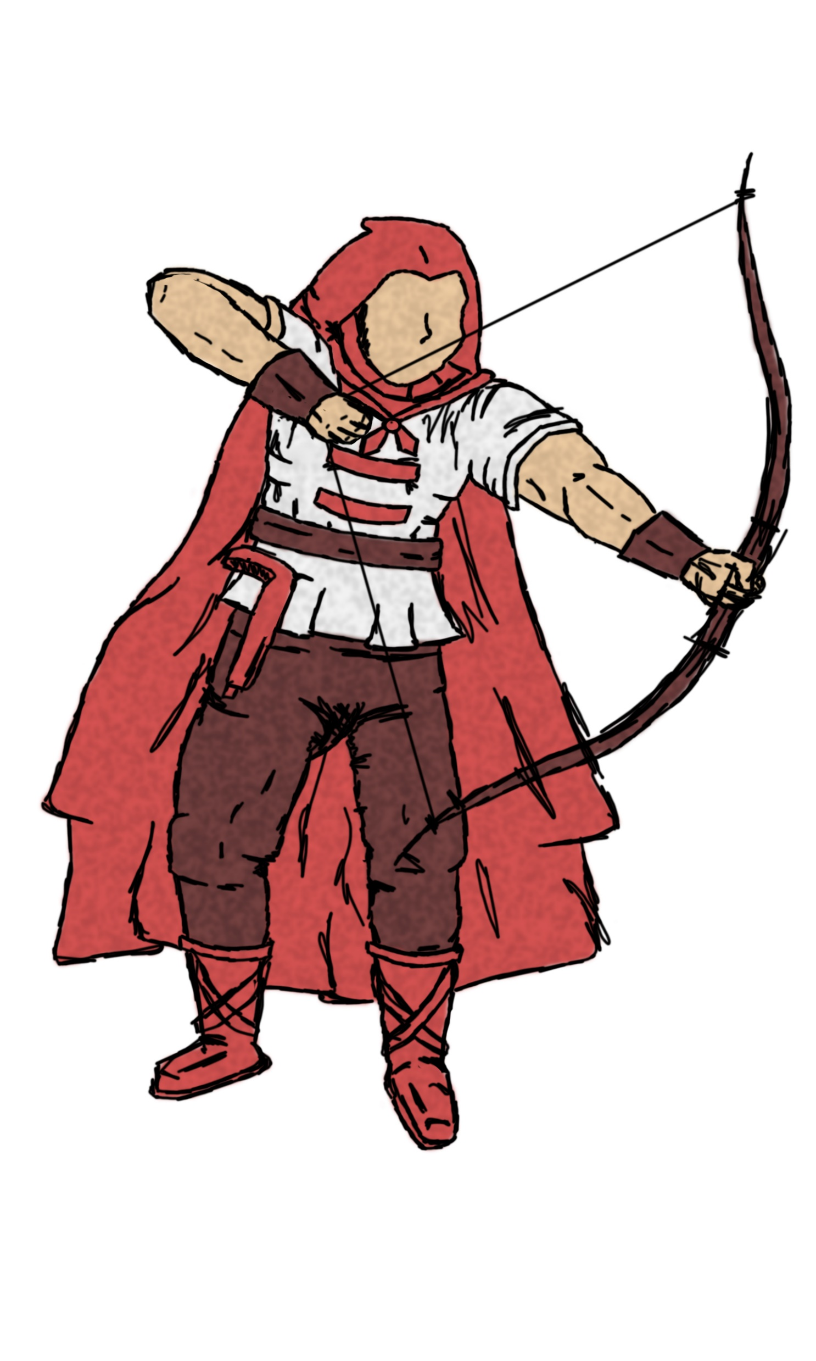
Idea Three – Monster Miner

Slide 14
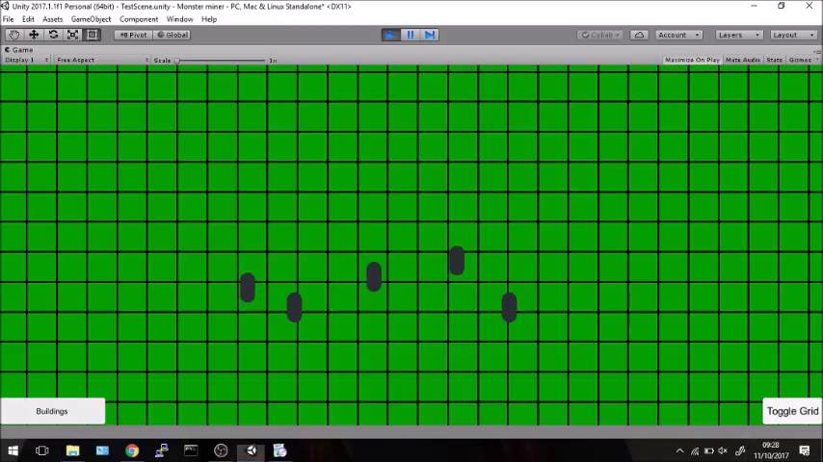
Idea Three – Monster Miner

Slide 15
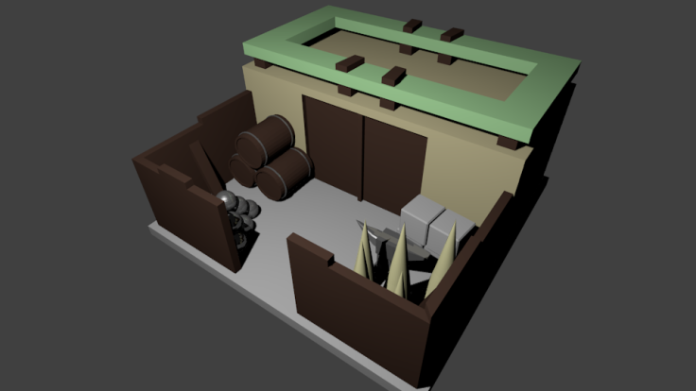
Final Idea
Monster Miner
Challenges
Brief

Slide 16
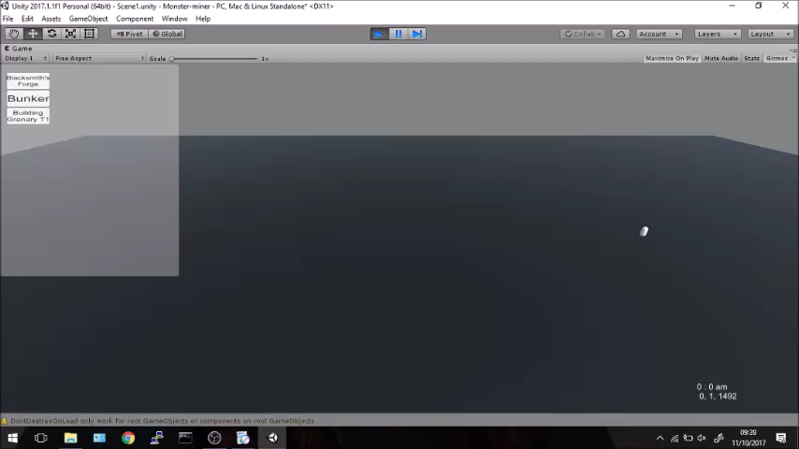
Current state

Slide 17
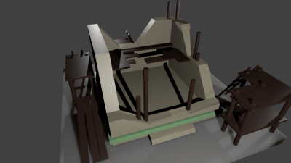
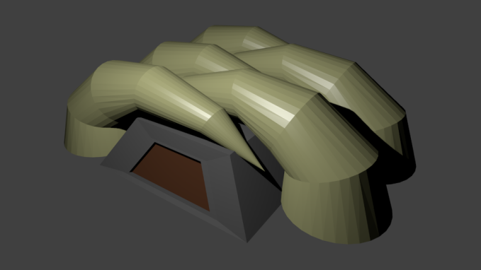
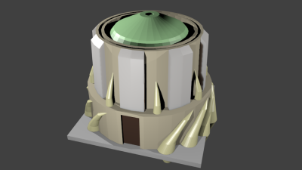
3d concept art

Slide 18
Questions?

